Slide 1
Hardware Dissection
Samsung Galaxy Note 20
and iPhone 4
Jason Bravo
Penn State World Campus

Slide 2
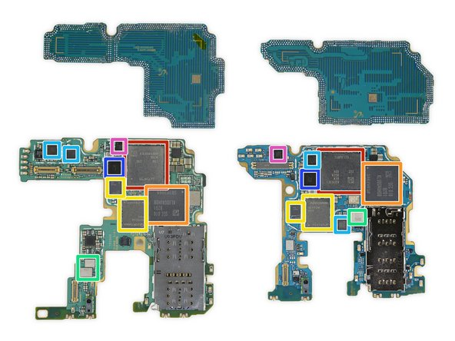
Samsung Galaxy Note 20 – Motherboard
Motherboard
The motherboard connects all internal components and enables communication between hardware.
Interesting fact: Samsung integrates many chips into a compact layered logic board.

Slide 3
Samsung Galaxy Note 20 – CPU/RAM/
STORAGE/
Snapdragon 865+ layered under Samsung LPDDR5 RAM
Samsung KLUDG4UHDB 128 GB universal flash storage
Interesting fact: This processor also contains GPU and AI processing cores.

Slide 4
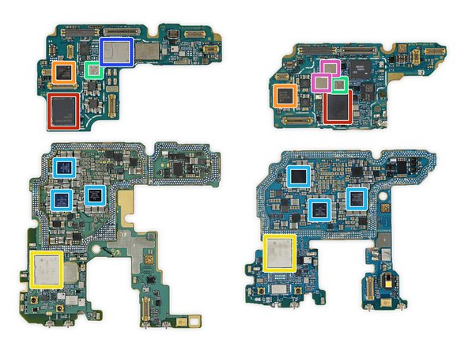
Samsung Galaxy Note 20 – Network Adapter
Network Adapter
Qualcomm SDR865 5G and LTE transceiver
Murata 1RH WiFi + Bluetooth module
Interesting fact: 5G modem enables ultra-fast internet speeds.

Slide 5
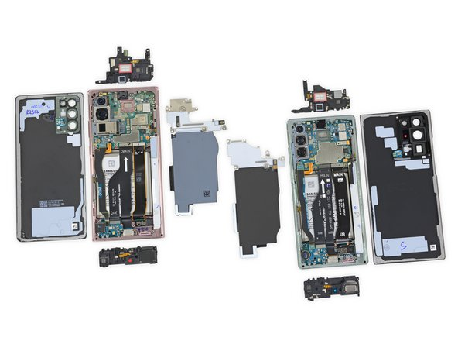
Samsung Galaxy Note 20 – Power Supply
Power Supply
Power Supply (internal battery)
The battery supplies power to the entire device.
Interesting fact: The battery is one of the largest components inside.

Slide 6
Samsung Galaxy Note 20 – Input Devices
Input Devices
Touchscreen
Digitizer
Touchscreen detects user input using capacitive sensors.
Interesting fact: The S Pen provides additional precision input.

Slide 7

Samsung Galaxy Note 20 – Output Devices
Output Devices
AMOLED Display
The AMOLED display and speakers provide visual and audio output.
Interesting fact: AMOLED displays offer vibrant colors and high contrast.

Slide 8
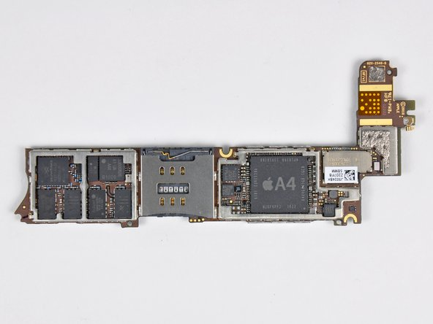
iPhone 4 – Motherboard
Motherboard
The logic board connects and controls all hardware components.
Interesting fact: Apple designs compact logic boards for efficiency.

Slide 9
iPhone 4 – CPU
CPU
A4 PROCESSOR (CPU)
The Apple A4 processor controls operations and executes programs.
Interesting fact: This chip was advanced for its time.

Slide 10
iPhone 4 – RAM
RAM
Integrated RAM
The iPhone 4’s RAM is integrated into the A4 processor to make the space more efficient.
RAM provides temporary storage for running apps.
Interesting fact: More RAM allows smoother multitasking.

Slide 11
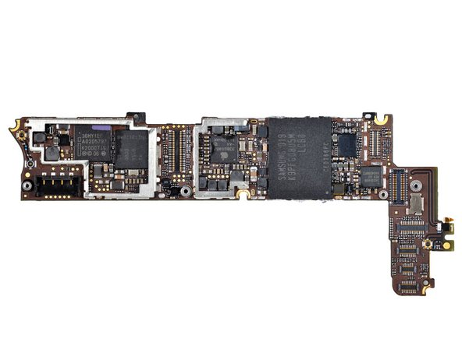
iPhone 4 – Storage
Storage
Flash Storage
Flash storage stores apps and user data.
Interesting fact: Flash memory has no moving parts.

Slide 12
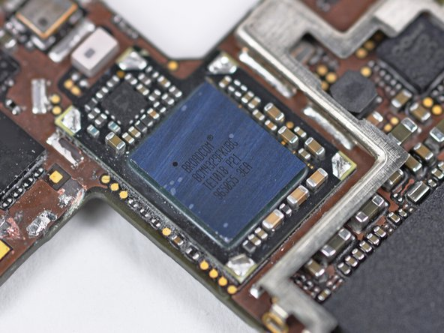
iPhone 4 – Network Adapter
Network Adapter
Wireless chips enable internet and cellular connections.
Interesting fact: The antenna is integrated into the phone frame.

Slide 13
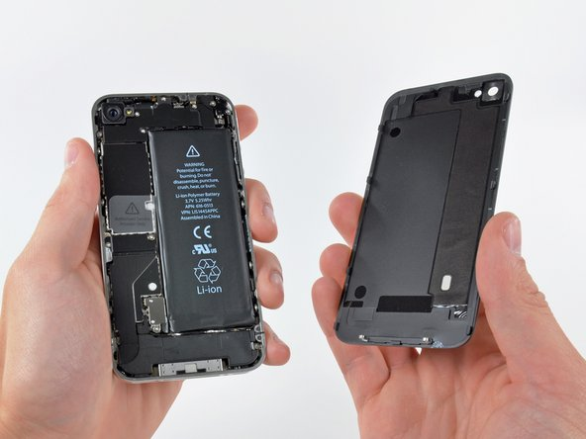
iPhone 4 – Power Supply
Power Supply
Lithium Battery (Power Supply)
The lithium battery provides power to the phone.
Interesting fact: Battery design affects device size and weight.

Slide 14
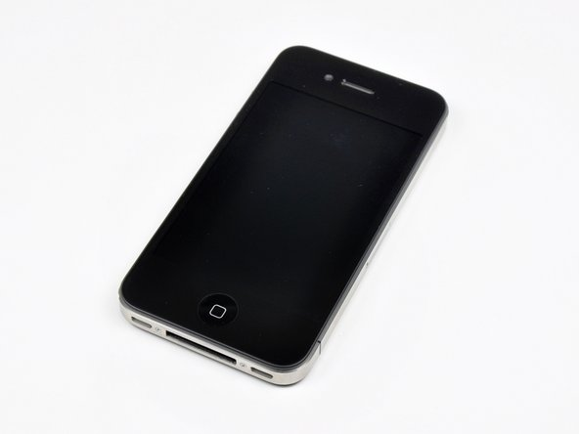
iPhone 4 – Input Devices
Input Devices
Touchscreen
Touchscreen and buttons allow user interaction.
Interesting fact: Touchscreens detect electrical signals from fingers.

Slide 15
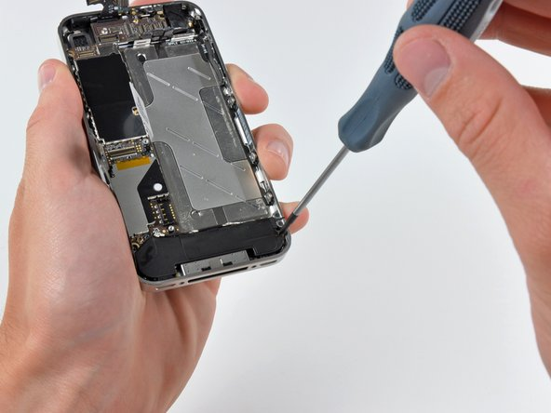
iPhone 4 – Output Devices
Output Devices
External Speakers
Display and speakers output visuals and sound.
Interesting fact: The Retina display improved screen clarity significantly.

Slide 16
Reflection
I chose the Samsung Galaxy Note 20 and iPhone 4 because they represent different generations of smartphone technology. The Galaxy Note 20 shows how modern phones integrate powerful processors, large batteries, and advanced connectivity like 5G. The iPhone 4 showed how earlier smartphones had similar components but were less compact and powerful.
The Note 20 was more complex internally, while the iPhone 4 was easier to understand because components were more separated. One interesting thing I learned was how integrated modern processors and RAM are, which improves performance. This activity helped me understand how hardware components work together inside smartphones.

